Slide 1
Understanding Your Emotions

Slide 2
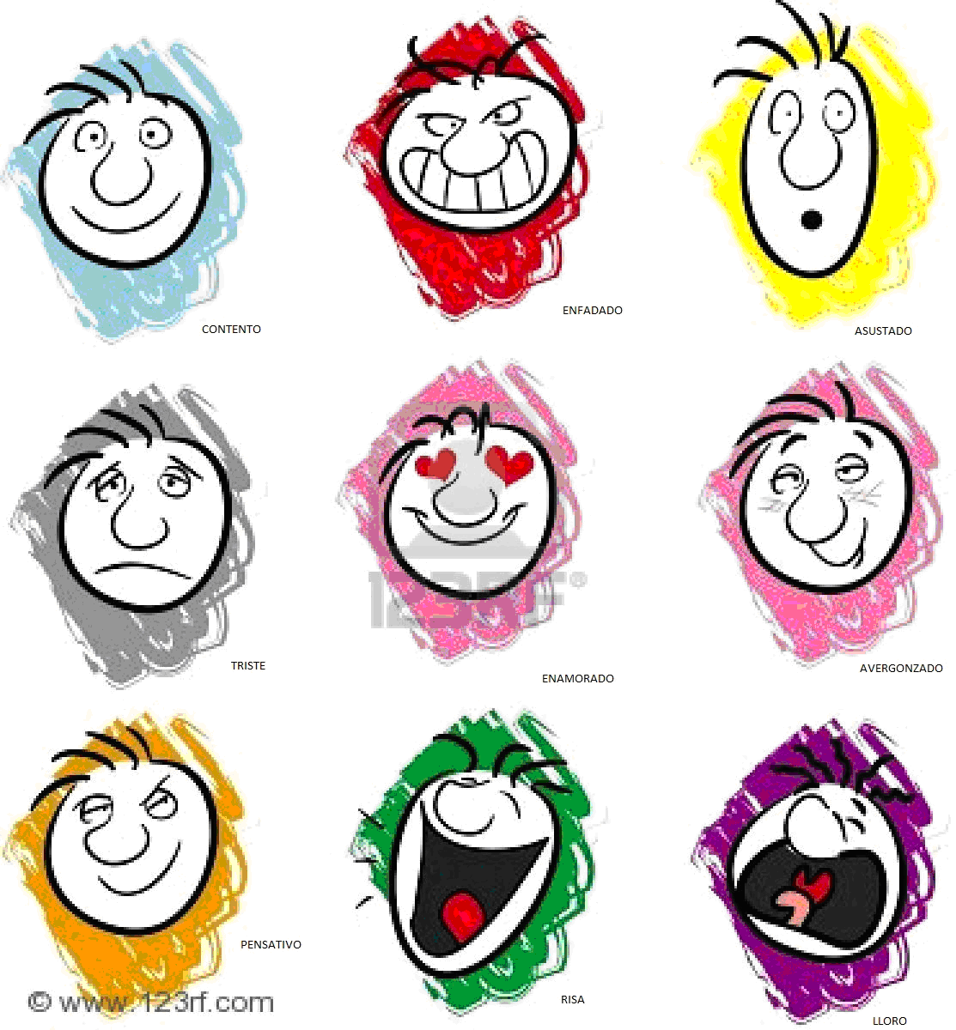
What are Emotions
EMOTIONS- Feelings such as love, joy and fear.
Almost every life experience has an emotional reaction.
Emotions can be hard to understand and recognize.
Emotions are not good or bad.
It is how you deal with them

Slide 3
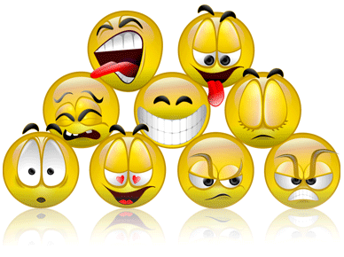
What are Emotions
All emotions are normal and healthy.
Even the unpleasant ones.
Learning to express and manage your emotions in a healthy way is important.
Be able to express them in ways that won’t hurt you or others.

Slide 4
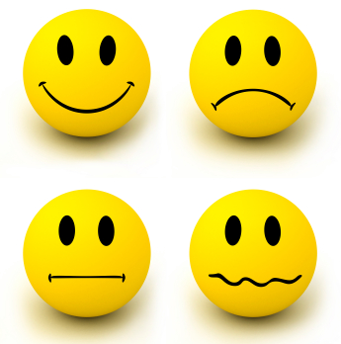
What Are Emotions
MOOD SWINGS- frequent changes in emotional state.
Normal among teens preteens.
Causes include
Hormone level changes
Worries and concerns.

Slide 5
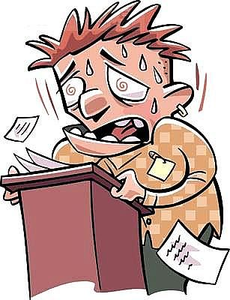
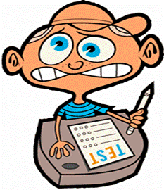
Dealing With Anxiety
ANXIETY- a state of uneasiness
A form or stress
A little anxiety can be a good thing
Gives you energy
Too Much anxiety can be harmful
Interfere with eating and sleeping

Slide 6
Dealing With Anxiety
Healthful ways to deal with anxiety
Talking with others
Writing about feelings in a journal
Physical activity
Running away from the cause of the anxiety is not helpful.
Facing the situation may develop skills that will help you deal with similar situations.

Slide 7
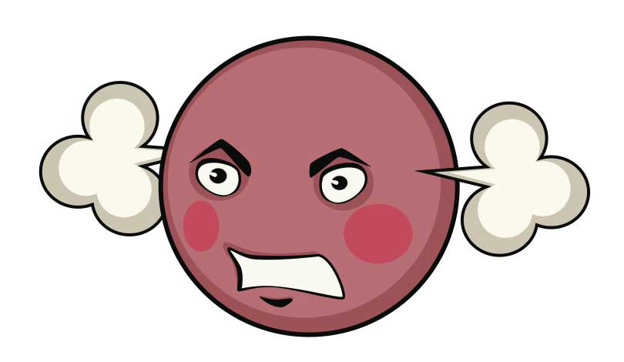
Dealing with Anger
Anger can be a tough emotion to deal with.
When angry you may tend to lash out at what is causing the anger.
Can be helpful in self defense situations
Anger is not a bad emotion
Does not need to be hidden
Need to find ways to express it in a way that does not hurt yourself or others.
Think about what is causing the anger and find a solution.
Find ways to relax if there is no real cause

Slide 8
Defense Mechanisms
Defense mechanisms are strategies people use to deal with emotions
Shift focus away from emotions you do not want to deal with.
Some are helpful while others can be harmful.

Slide 9
Defense Mechanisms
Denial
You refuse to face a feeling you do not want to accept.
Projection
You pretend someone else is having these feelings
Displacement
You take the feelings out on someone other than the person who hurt you
Sublimation
You redirect your feelings into some other more positive activity

Slide 10
Your Emotional Needs
EMOTIONAL NEEDS- needs that affect a person’s feelings and sense of well-being
The need to love and be loved
The need to belong
The need to make a difference in the world
Do something that matters and be valued for it

Slide 11
Your Emotional Needs
Meeting your emotional needs:
To be loved spend time with those who care about you.
To belong be part of your family, join a group or club or sport
To make a difference help out in your community or do things to help others.

